Slide 1
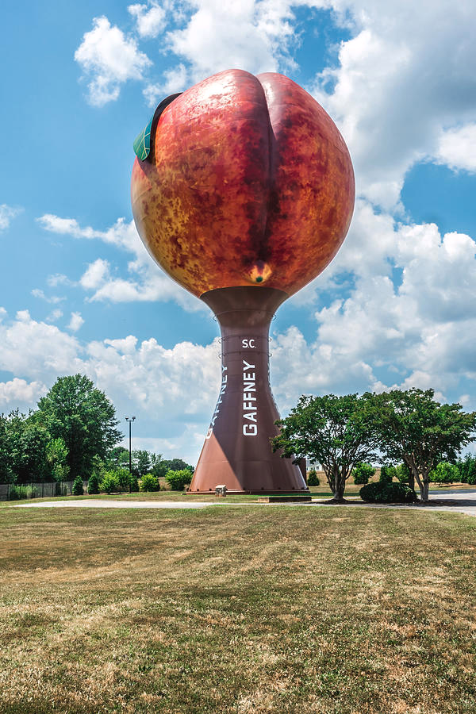

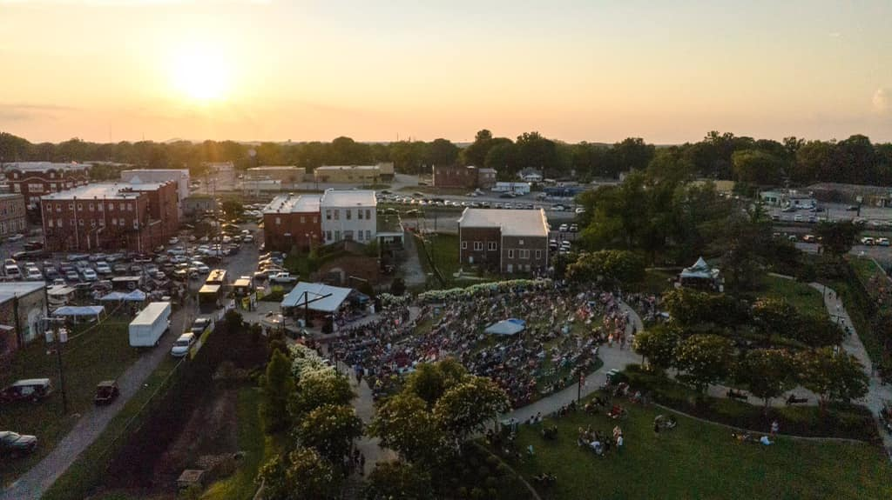
2023 SC Peach Festival Sponsorship Packages
South Carolina Peach Festival
PO Box 549
Gaffney, SC 29342
TheSouthCarolinaPeachFestival@yahoo.com
https://www.southcarolinapeachfest.com/
#PartyAtThePeach

Slide 2








































Thank you to our 2022 Sponsors!

Slide 3
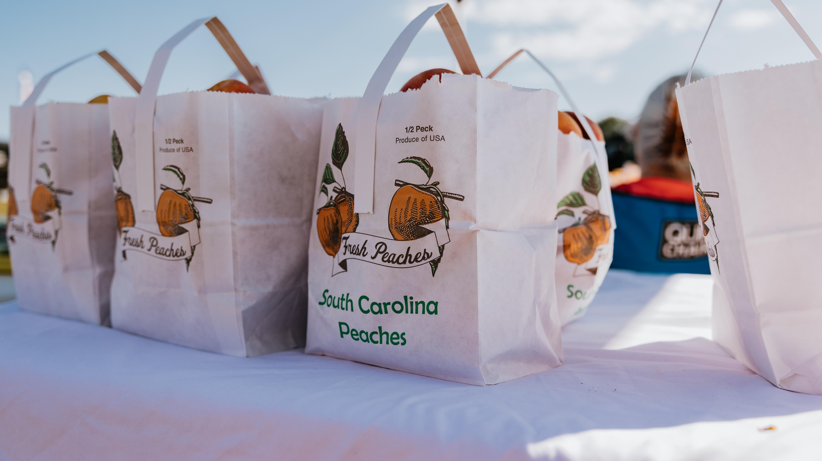
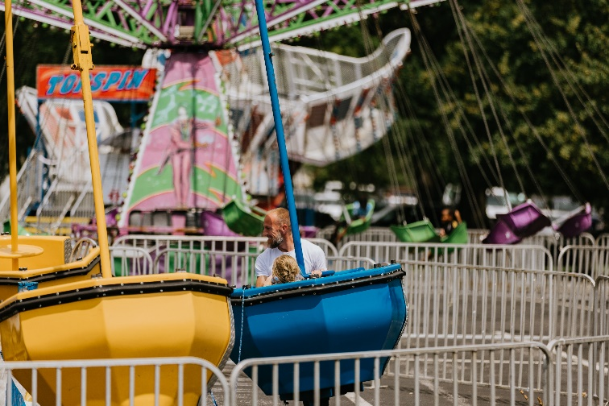
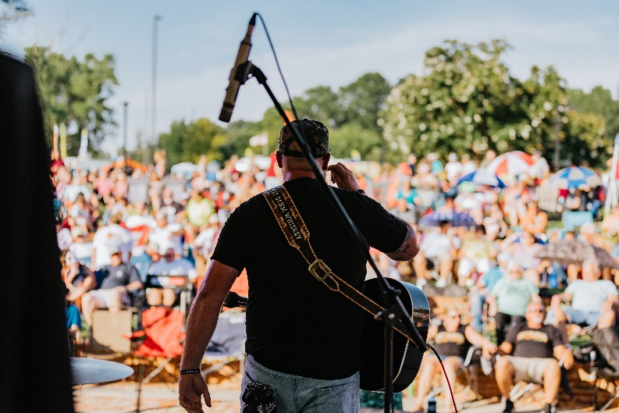

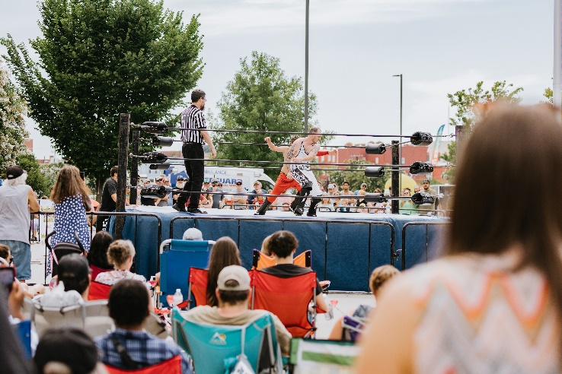
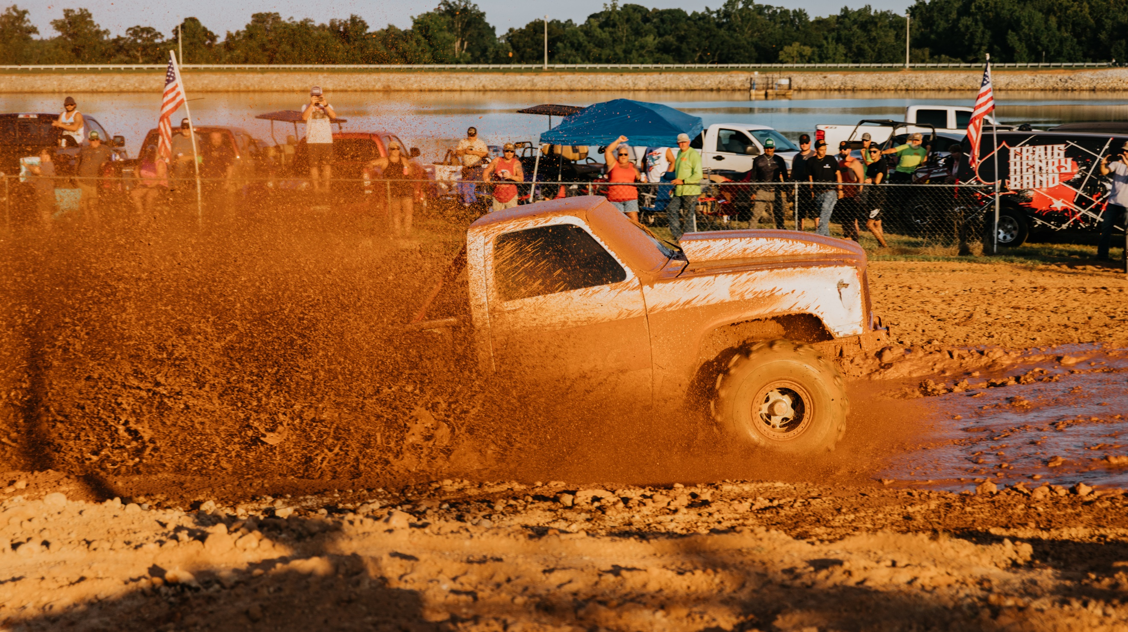
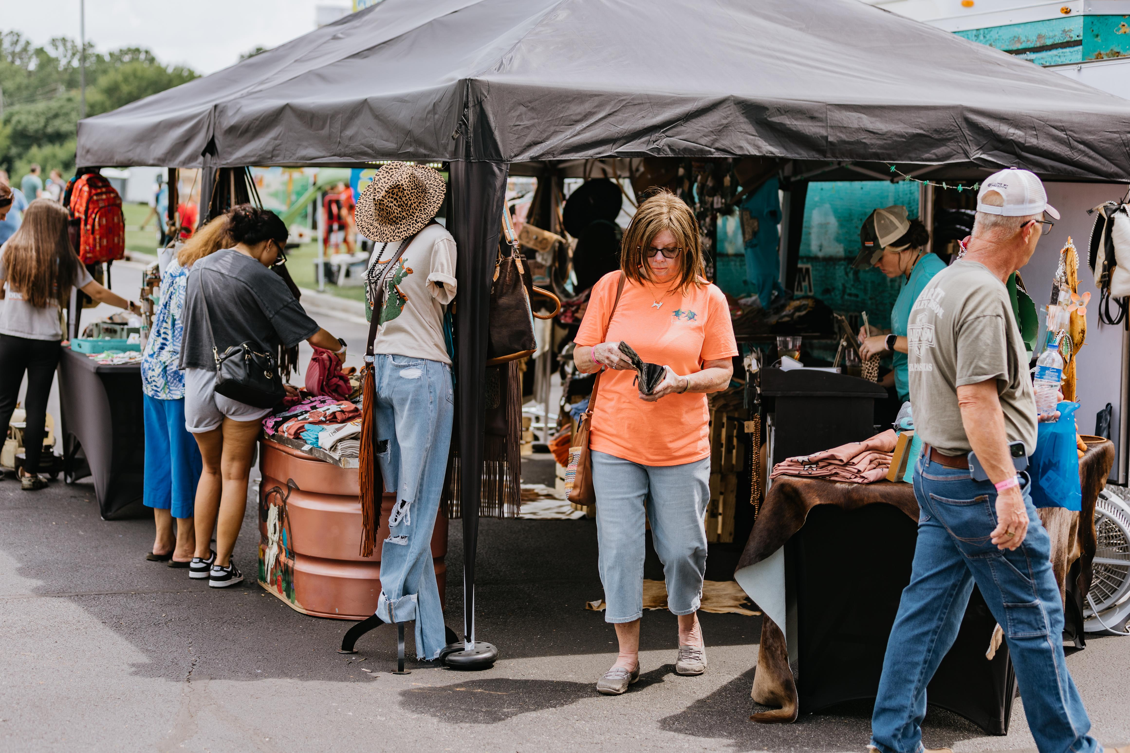
The Peach Festival is the largest tourist event in Cherokee County, offering low-cost to free entertainment for the entire family thanks to our local sponsor support!

Slide 4
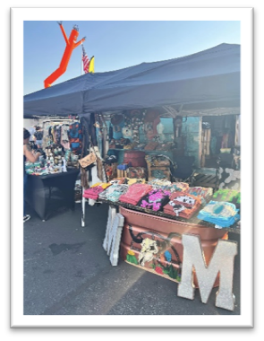
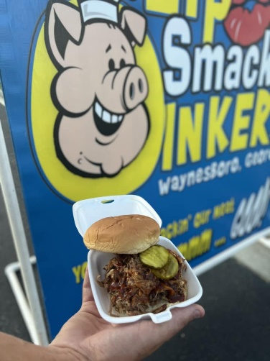
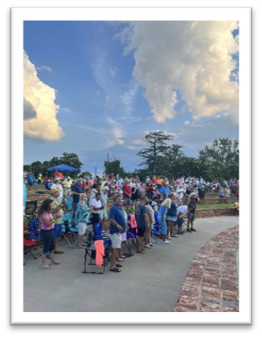
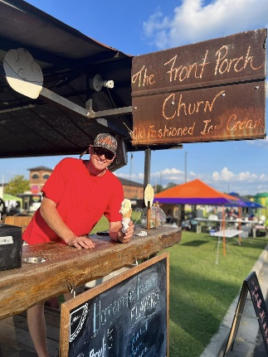
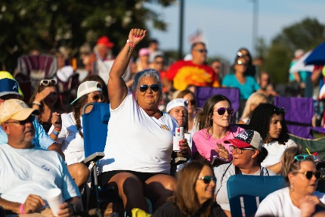
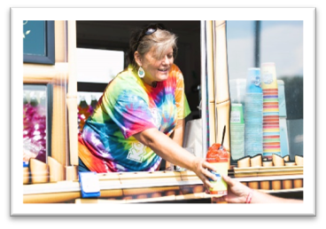
Events Schedule
Wednesday, July 12th
Praise & Worship at Jolly Park
Friday, July 14th
Dessert Contest
Kickoff Party at Jolly Park
Music, Food Vendors, Carnival
Arts and Crafts
Concerts at Jolly Park
Lainey Wilson Concert at Lake Whelchel
Saturday, July 15th
Arts and Crafts
Parade
Dog Show
Wrestling
Car Cruise-In
Community Stage
Concerts at Jolly Park
Friday, July 21st
Car Race at Cherokee Speedway
Saturday, July 22nd
Pageant
Mud Bog at Lake Whelchel

Slide 5

IN-KIND SPONSORSHIPS
VOLUNTEERS
FOOD
LODGING
ADVERTISEMENT
MERCHANDISE
While the Peach Festival requires monetary support to make our events successful, we also need partnerships with businesses for in-kind sponsorships. In-Kind sponsorships help save money we would otherwise need to spend to make the festival successful. Many ideas, such as food, lodging, and advertisement, are listed above. We appreciate any support you can invest in making this year's South Carolina Peach Festival the best one yet!
Contact us today to become one of our In-Kind Sponsors!
Jessica Willard at 864-491-7390 / Gayle White at 864-490-0133
thesouthcarolinapeachfestival@yahoo.com

Slide 6
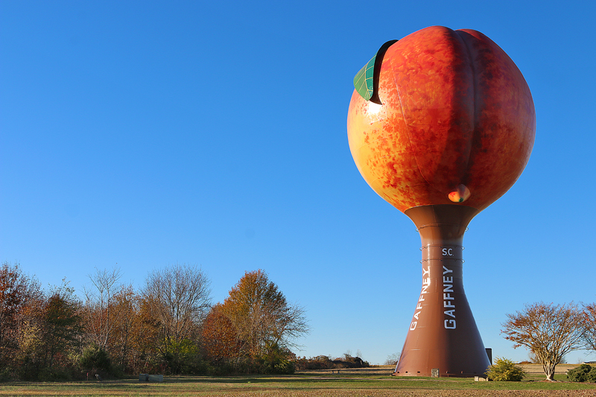
Choose your Peach level!

Slide 7

Corporate Sponsorship Commitment Form
Please print all names legibly and exactly as they should appear in all publications.
Business Name: ____________________________________________ (as it appears in print)
Contact Name: __________________________________________________________________
Mailing address: _________________________________________________________________
City / State / Zip: ___________________________________ Phone: _______________________
Type of contribution (please mark one):
Cash/Check Sponsorship Dollar Amount: $______________
In-Kind Item(s) Donated: ___________________________________________________________
Please mark and return for benefits according to level.
Sponsorships received before June 23, 2023, will be recognized according to levels. We are a 501(c) 6.
Please enclose a check payable to The South Carolina Peach Festival. We thank you for your contribution.
_____________________________________________________
Signature of sponsor
Please email the logo in jpg format for promotional use to thesouthcarolinapeachfestival@yahoo.com. For questions or concerns, please contact Jessica Willard at 864-491-7390 or Gayle White at 864-490-0133.
Please sign the form and return it to:
THE SOUTH CAROLINA PEACH FESTIVAL, INC.
P.O. BOX 549
GAFFNEY, SC 29342
https://www.southcarolinapeachfest.com/(2023 Benefit Form)
______ Parade Entry
______ Vendor Space
Shirt Sizes & Qty: Small _____
Medium _____
Large _____
X-Large _____
XX-Large _____
XXX-Large _____
Please select the benefits for the level you would like to participate in. Also, complete and return the appropriate forms for the respective benefits (2023 Benefit Form).

Slide 8


